Slide 1
DATA SCIENCE FINAL PROJECT
-Tsering Sandup Ukyab

Slide 2
Can we predict Yield using Temperature, Humidity, CO2 Level and Light?

Slide 3
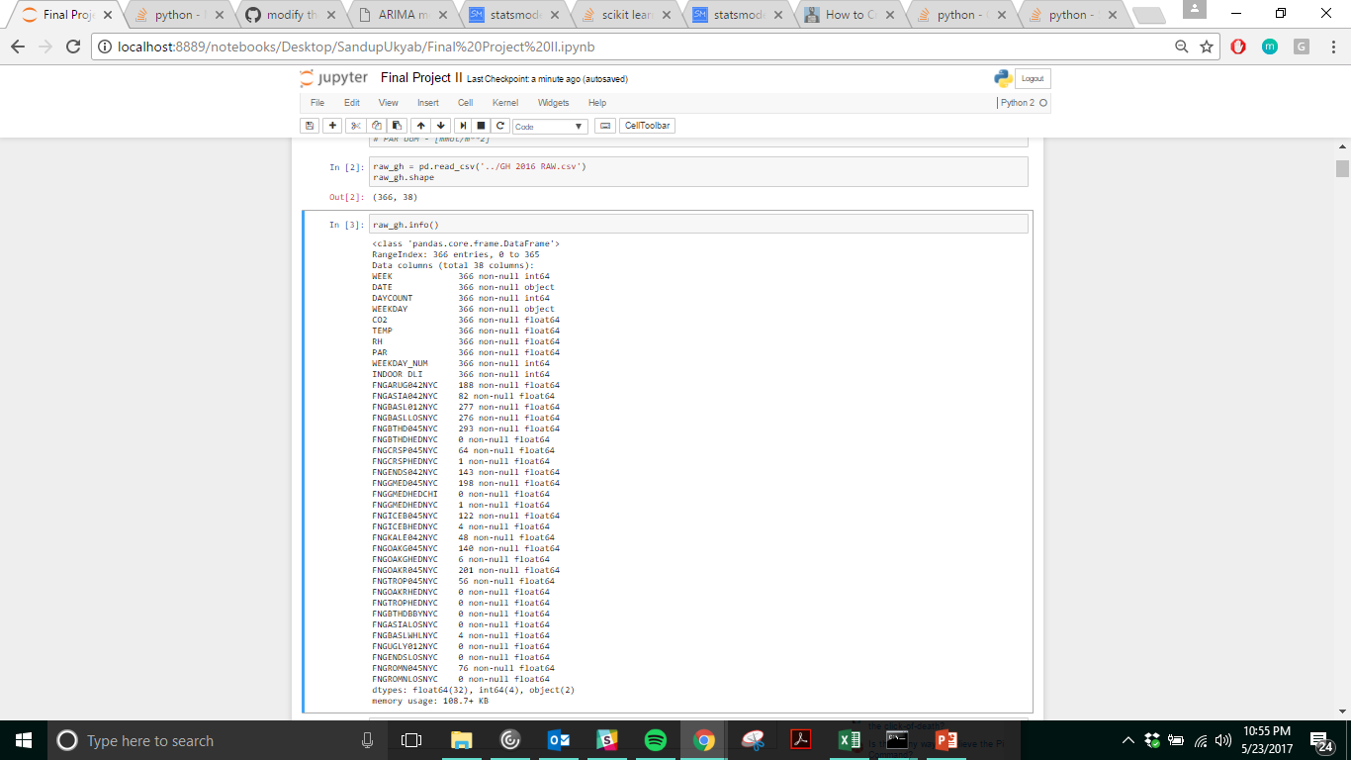
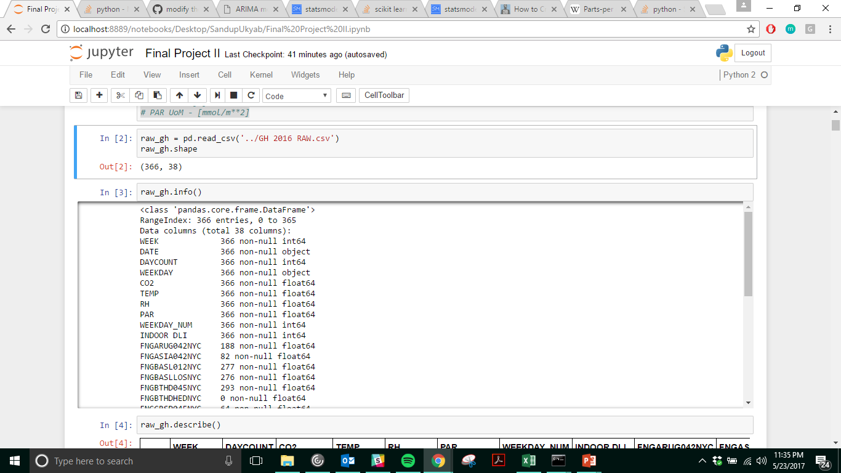
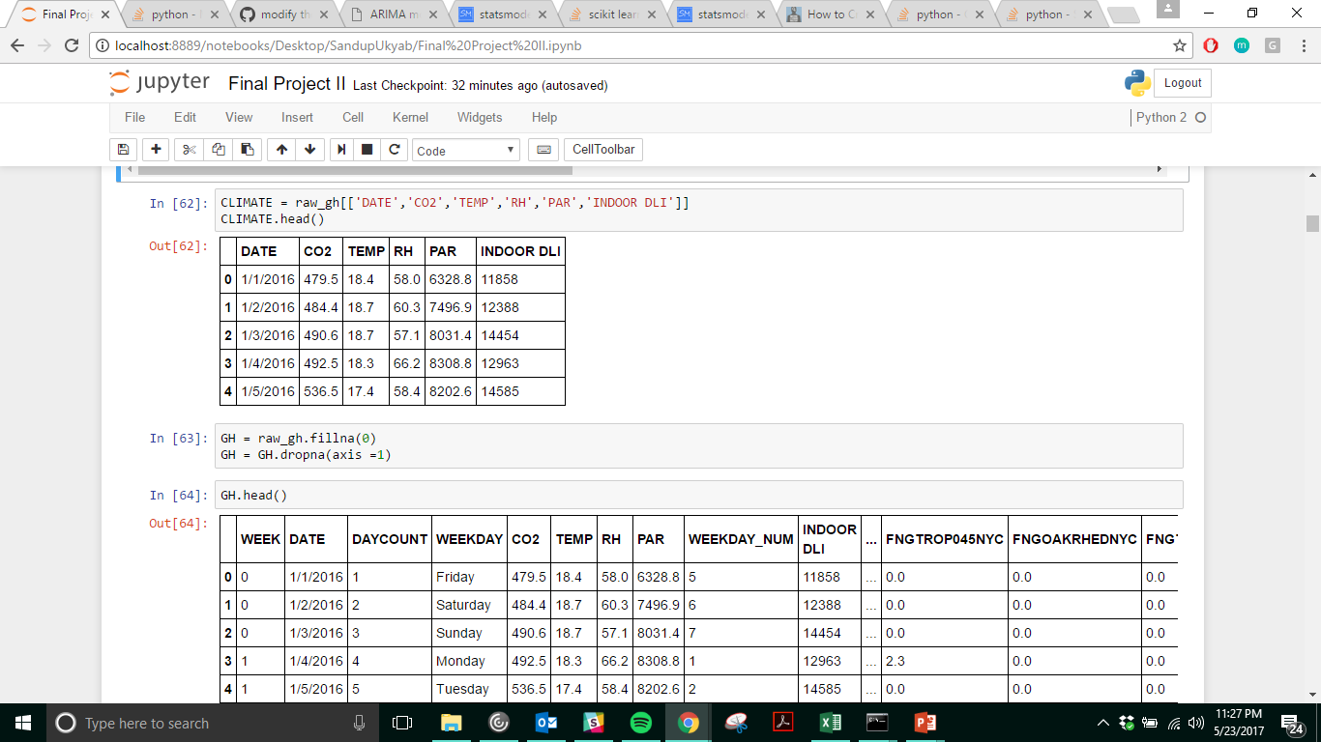
DATA
SHAPE (366, 38)
CO² – ppm [parts per million]
TEMP – Celsius
RH (Relative Humidity)- %
PAR – mmol /m²

Slide 4
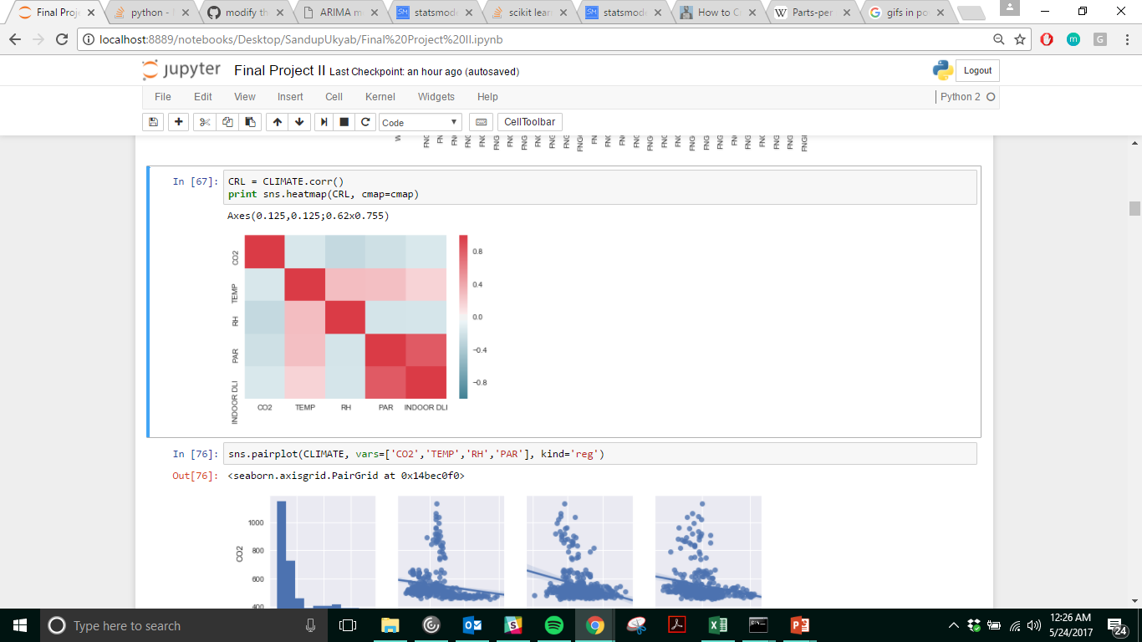
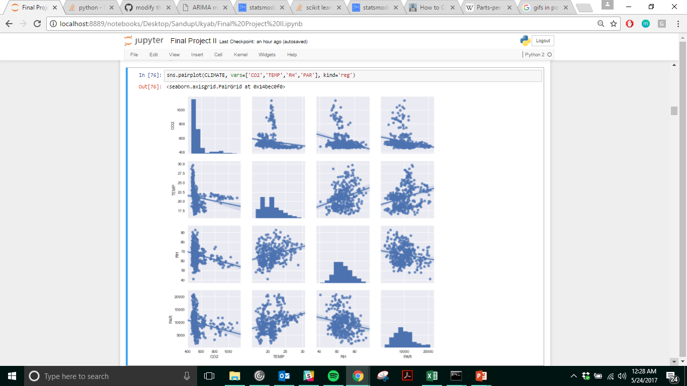
INDEPENDENT VARIABLES:
CLIMATE
HIGH (+ve) CORRELATION BETWEEN INDOOR DLI & PAR.
INDOOR DLI WAS DROPPED
LOW (+ve) CORRELATION BETWEEN TEMP & RH // TEMP & PAR

Slide 5
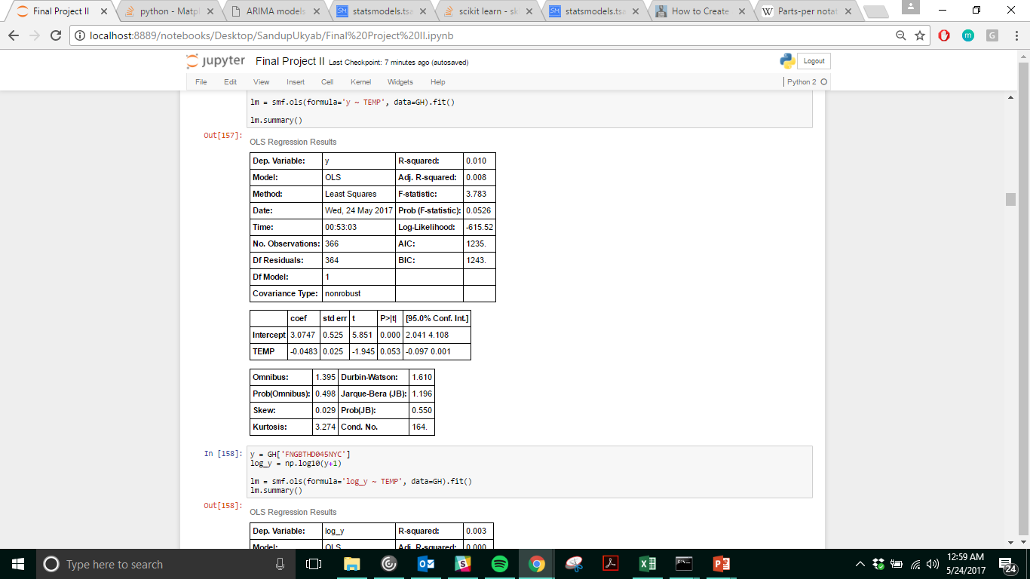
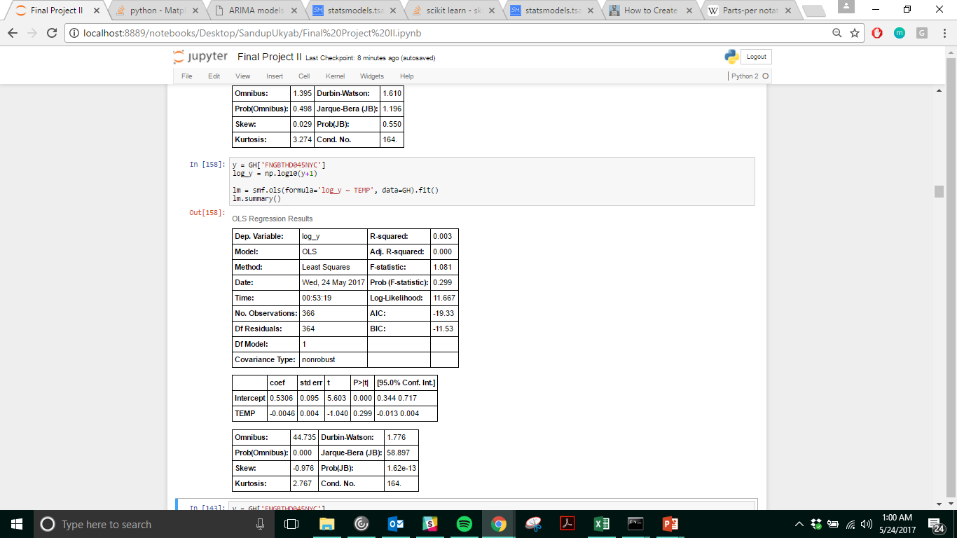
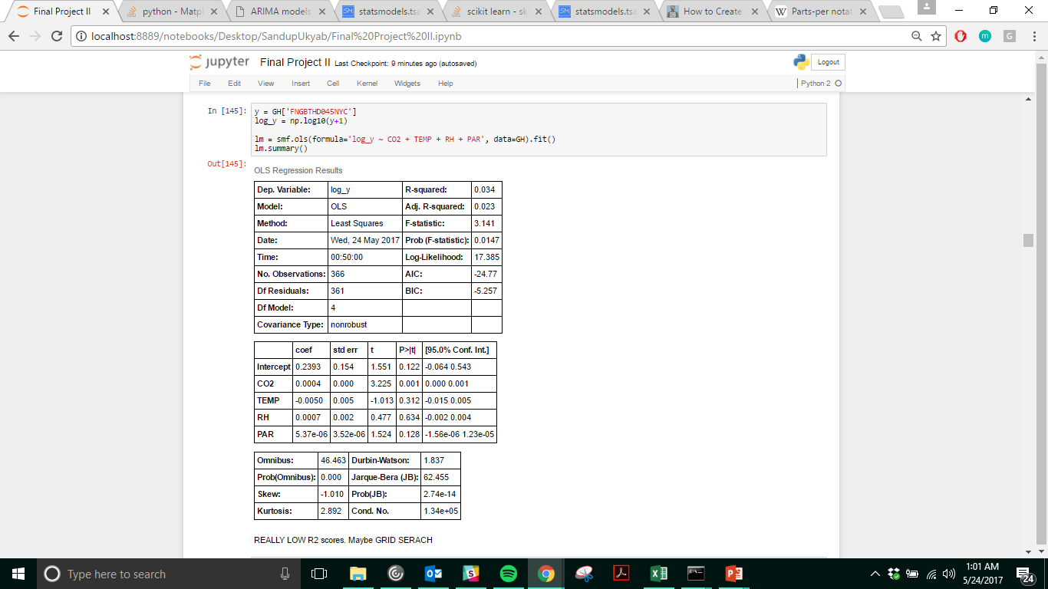
LINEAR REGRESSION
REALLY LOW R- squared VALUES.
DON’T THINK LINEAR REGRESSION IS THE WAY TO GO.

Slide 6
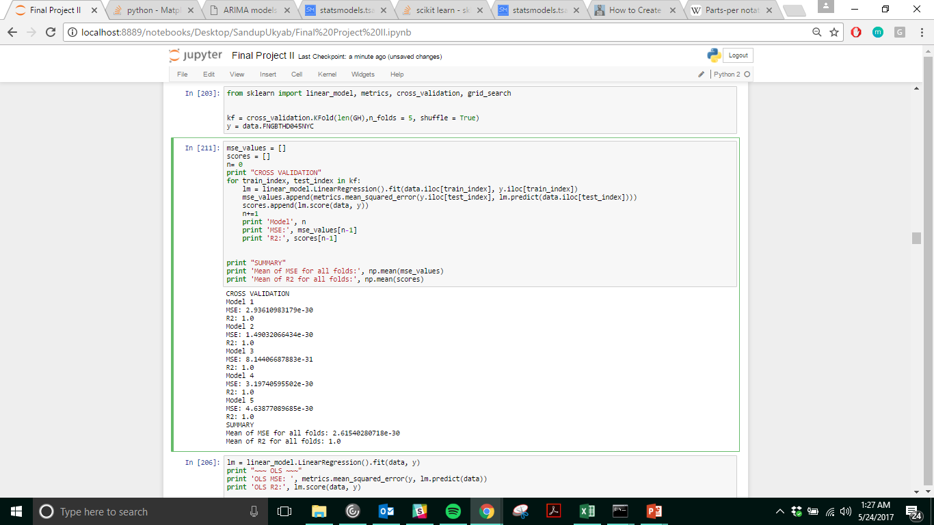
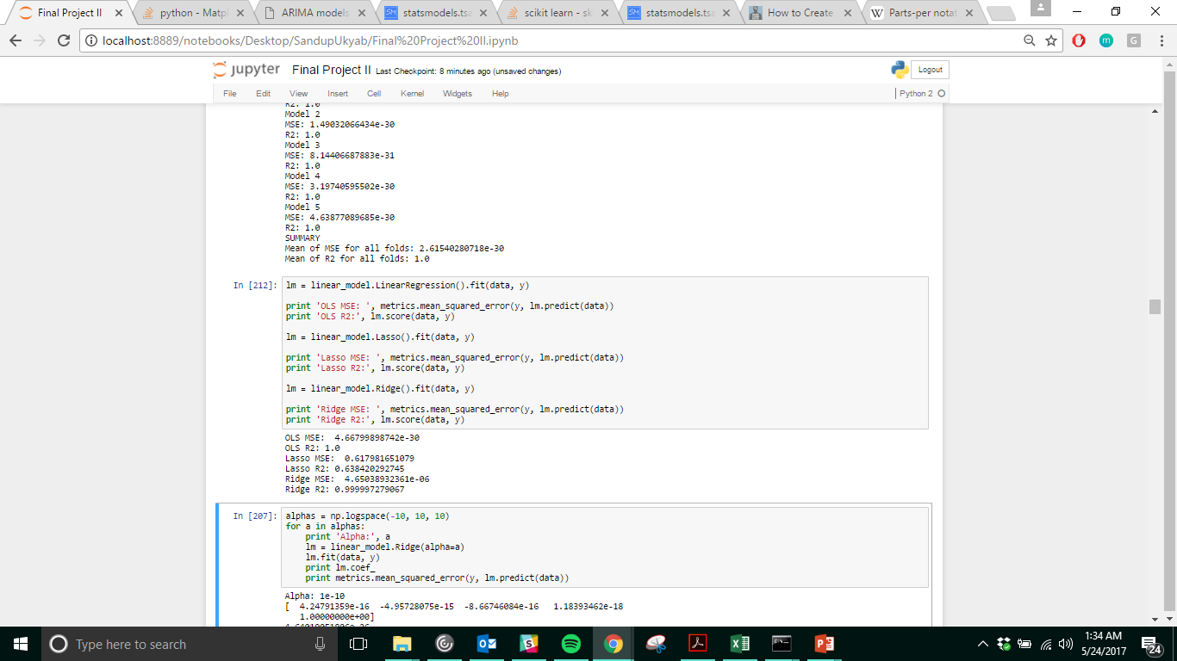
GRID SEARCH
K-fold Cross Validation
OLS vs Lasso vs Ridge
The CROSS VALIDATION & GRID SEARCH approach shows a completely different result from the OLS Linear Regression Results.
Really High R2 for all Models.
BEST ESTIMATOR
4.12552188623e-25 Ridge(alpha=1e-10, copy_X=True, fit_intercept=True, max_iter=None, normalize=False, random_state=None, solver='auto', tol=0.001)
GRID SEARCH PARAMETERS
GridSearchCV(cv=None, error_score='raise', estimator=Ridge(alpha=1.0, copy_X=True, fit_intercept=True, max_iter=None, normalize=False, random_state=None, solver='auto', tol=0.001), fit_params={}, iid=True, n_jobs=1, param_grid={'alpha': array([ 1.00000e-10, 1.66810e-08, 2.78256e-06, 4.64159e-04, 7.74264e-02, 1.29155e+01, 2.15443e+03, 3.59381e+05, 5.99484e+07, 1.00000e+10])}, pre_dispatch='2*n_jobs', refit=True, scoring='mean_squared_error', verbose=0)

Slide 7



What is life ?

Slide 8
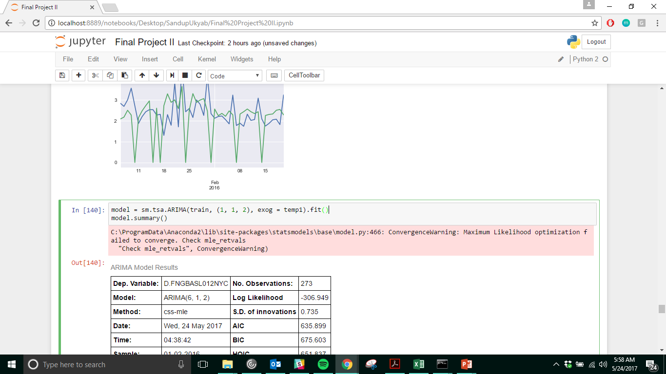
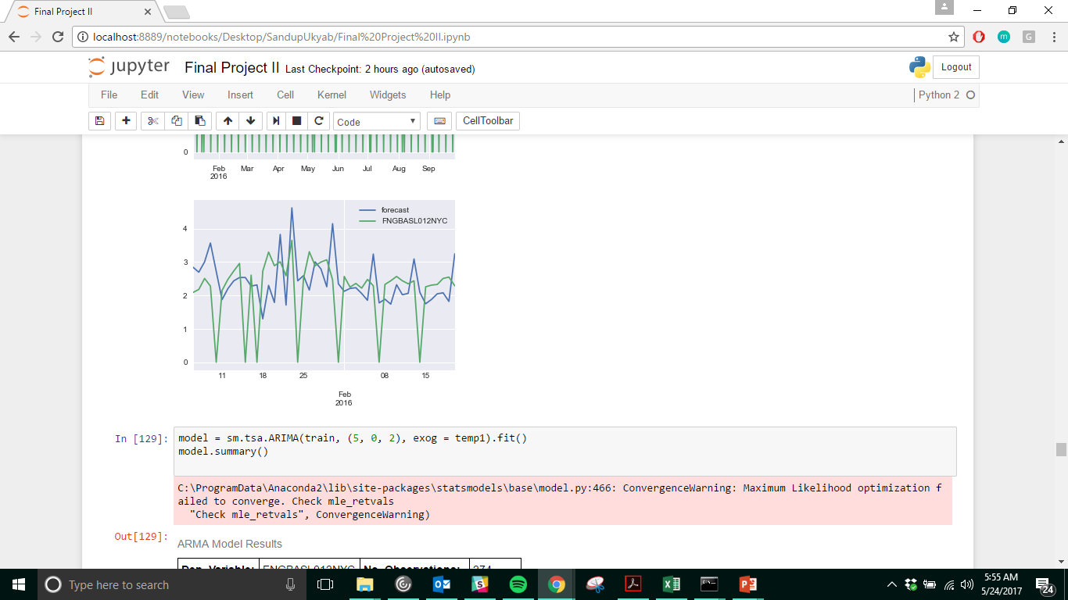
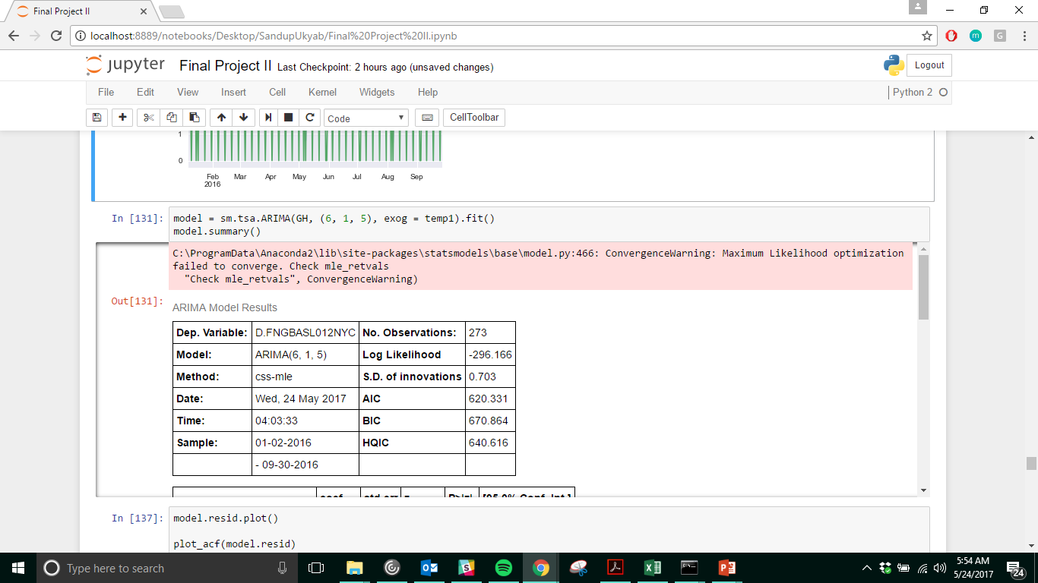
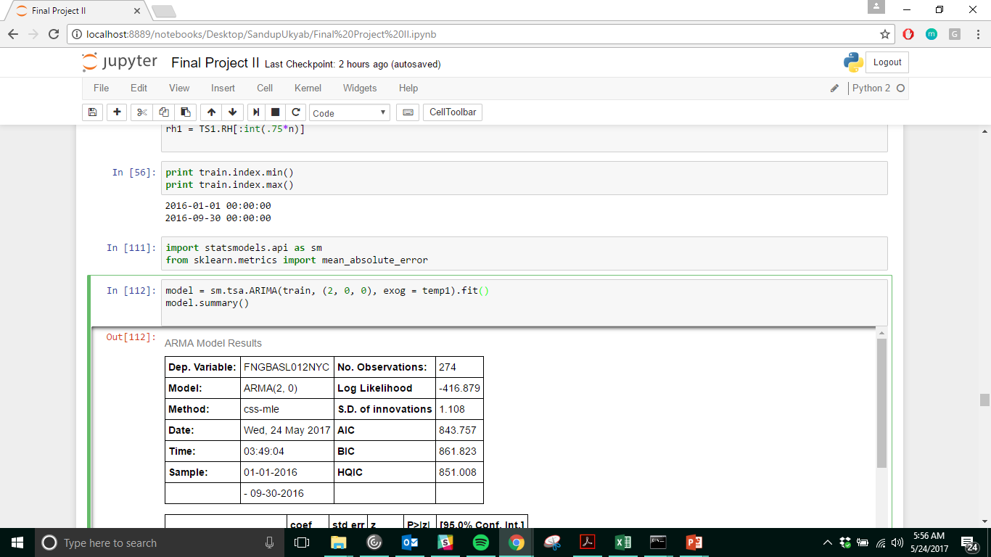
TIME SERIES
ARIMA MODEL- Autoregressive Integrated Moving Average

Slide 9
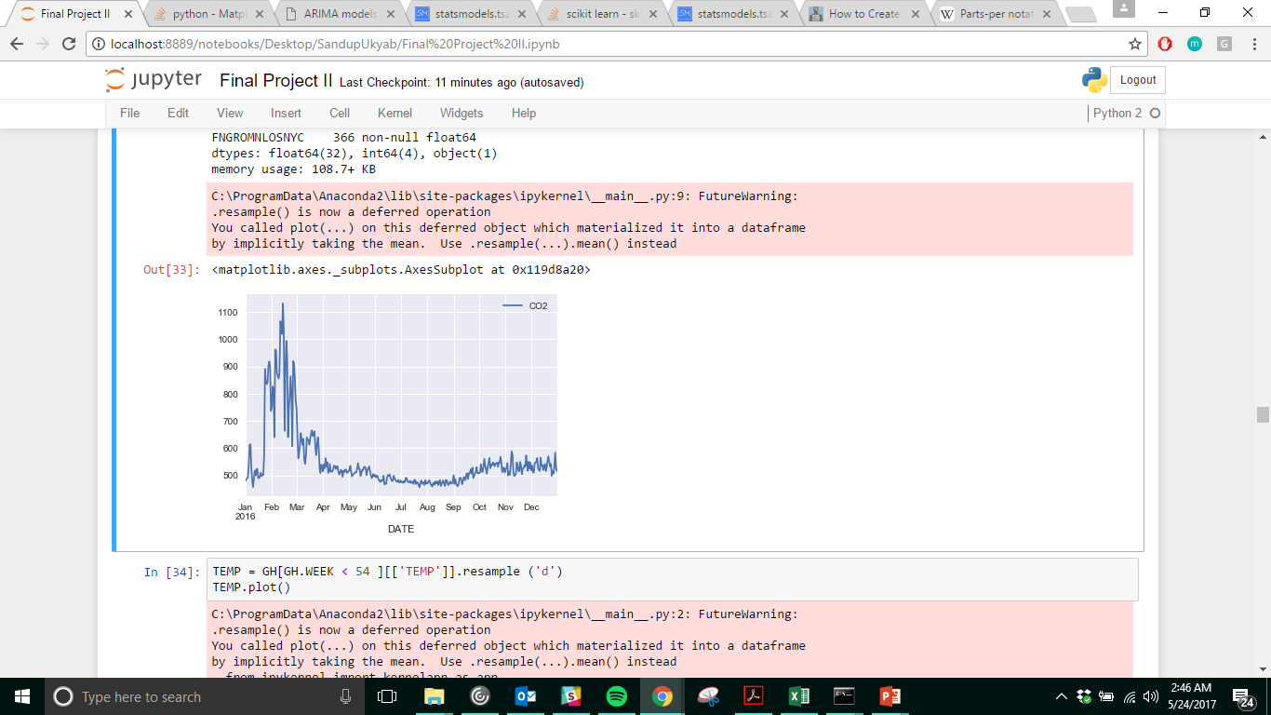
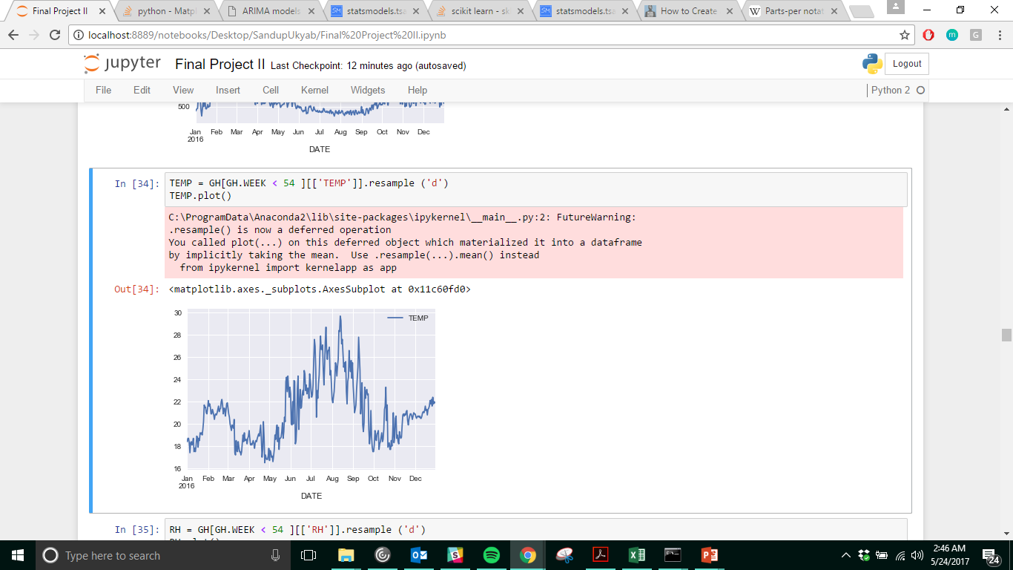
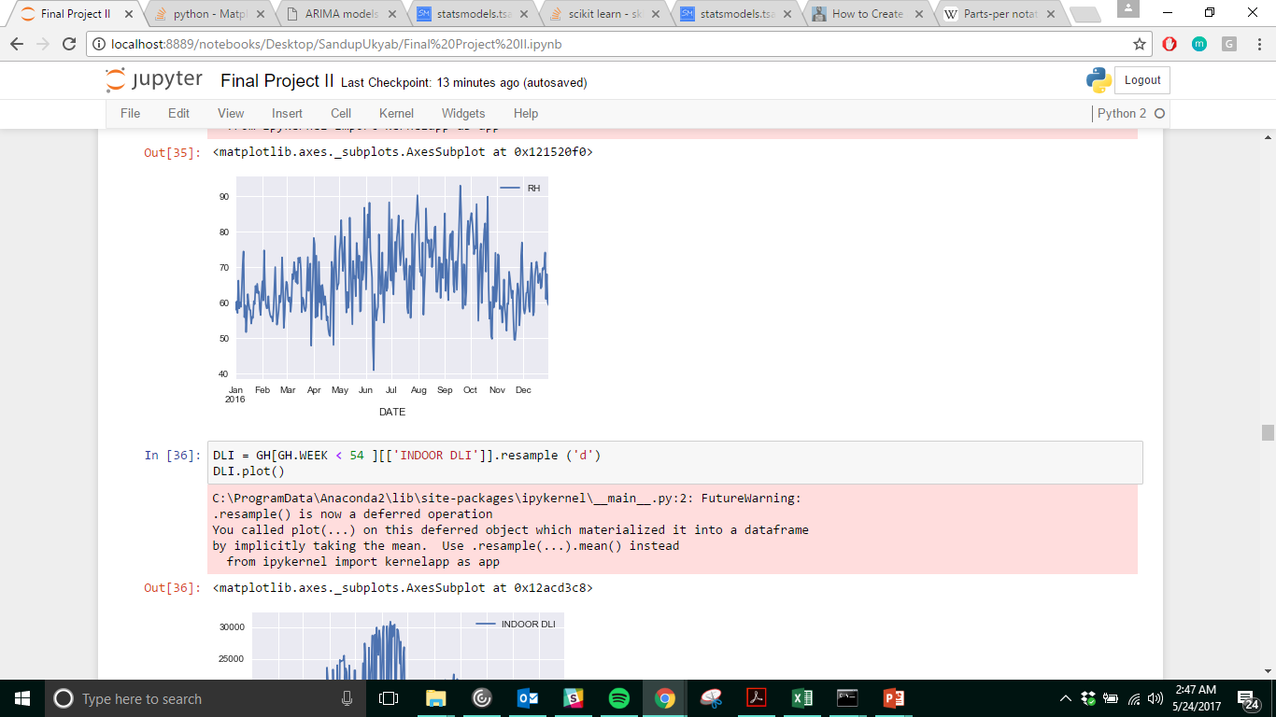
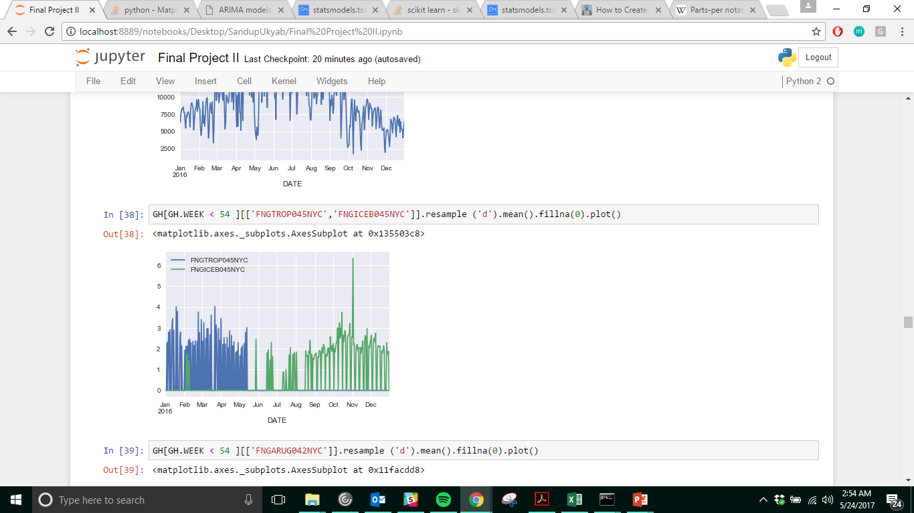
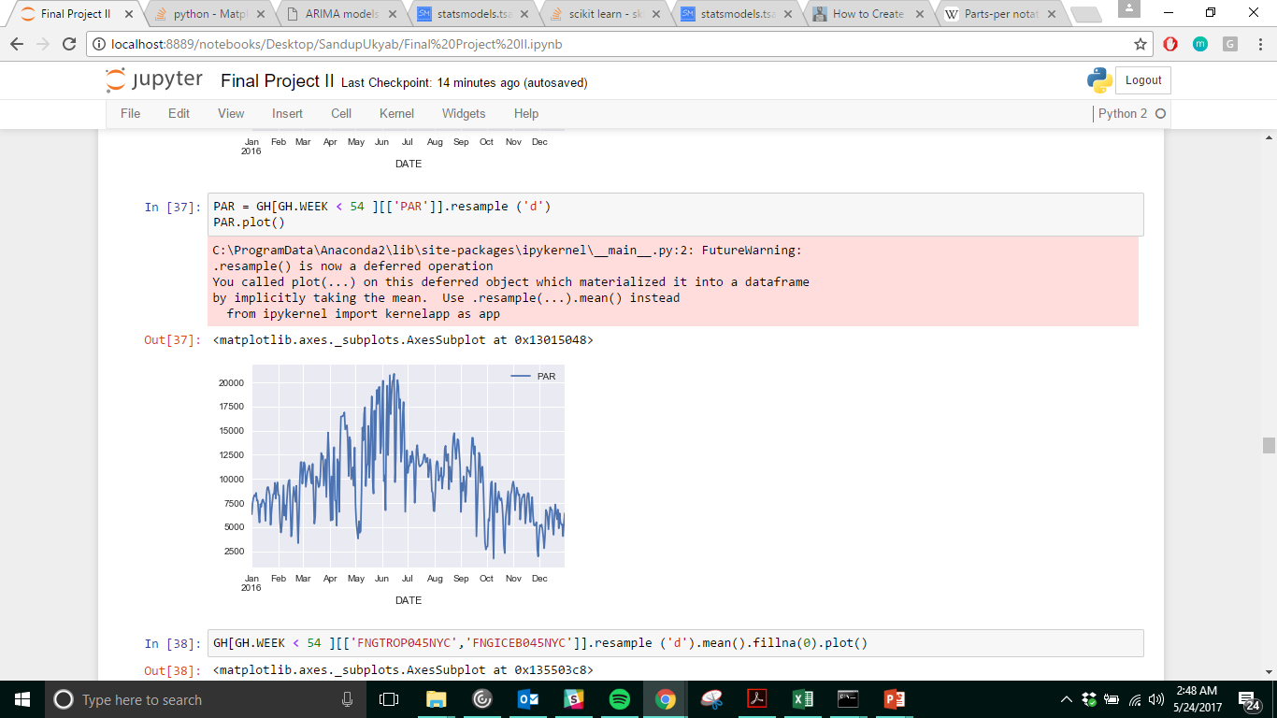
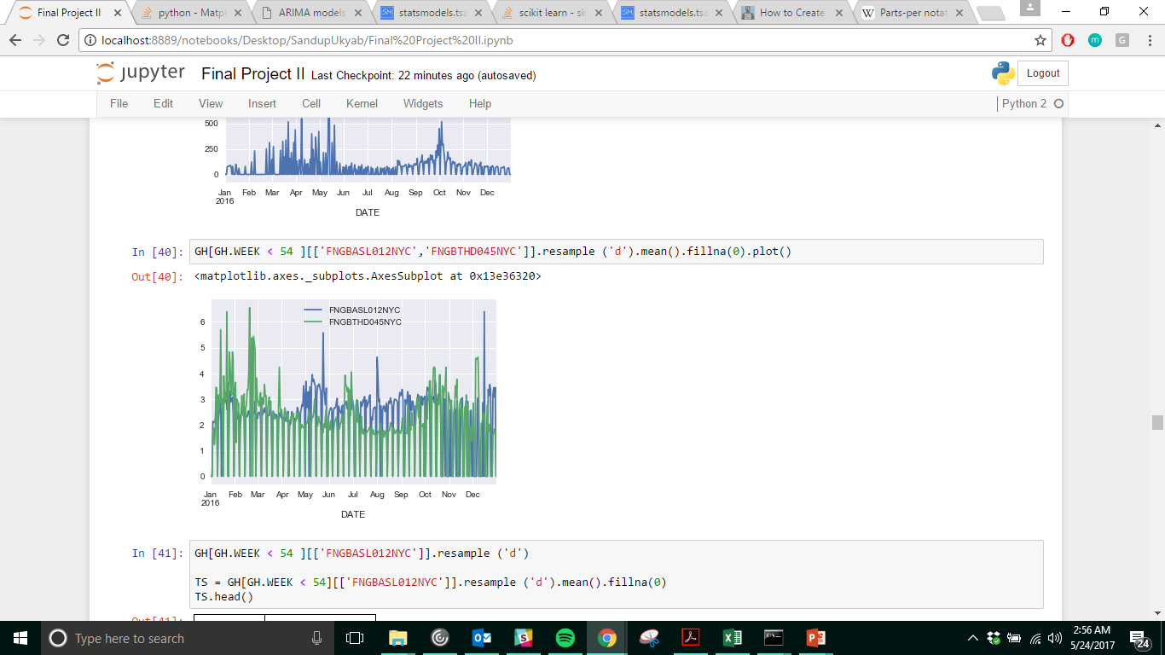
CO2 levels for 2016
Temperature for 2016
Relative Humidity levels for 2016
YIELD FOR 4 SEPARATE VARIETIES OF LETTUCE
PAR levels for 2016

Slide 10
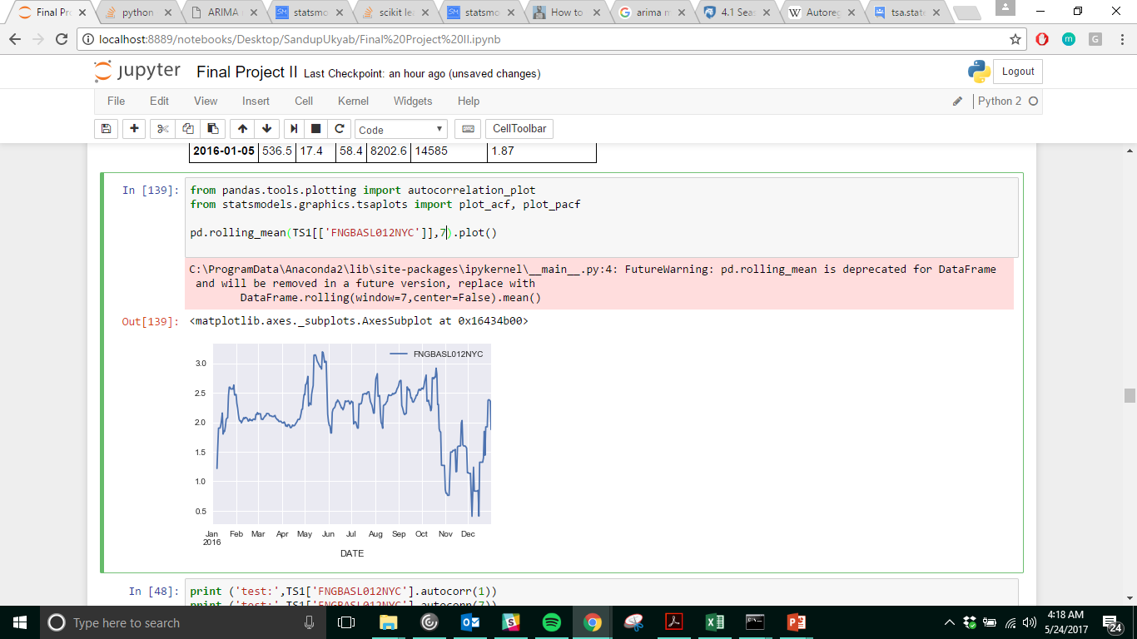
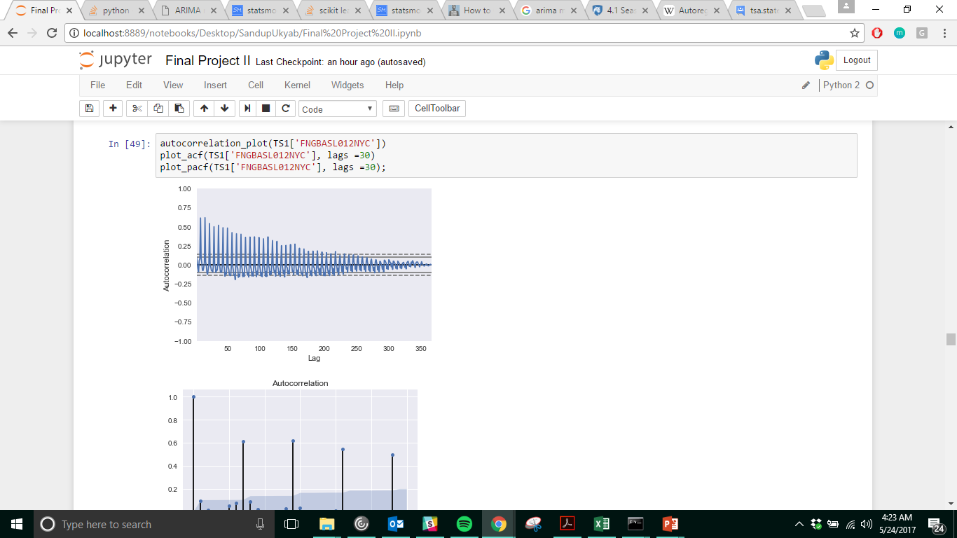
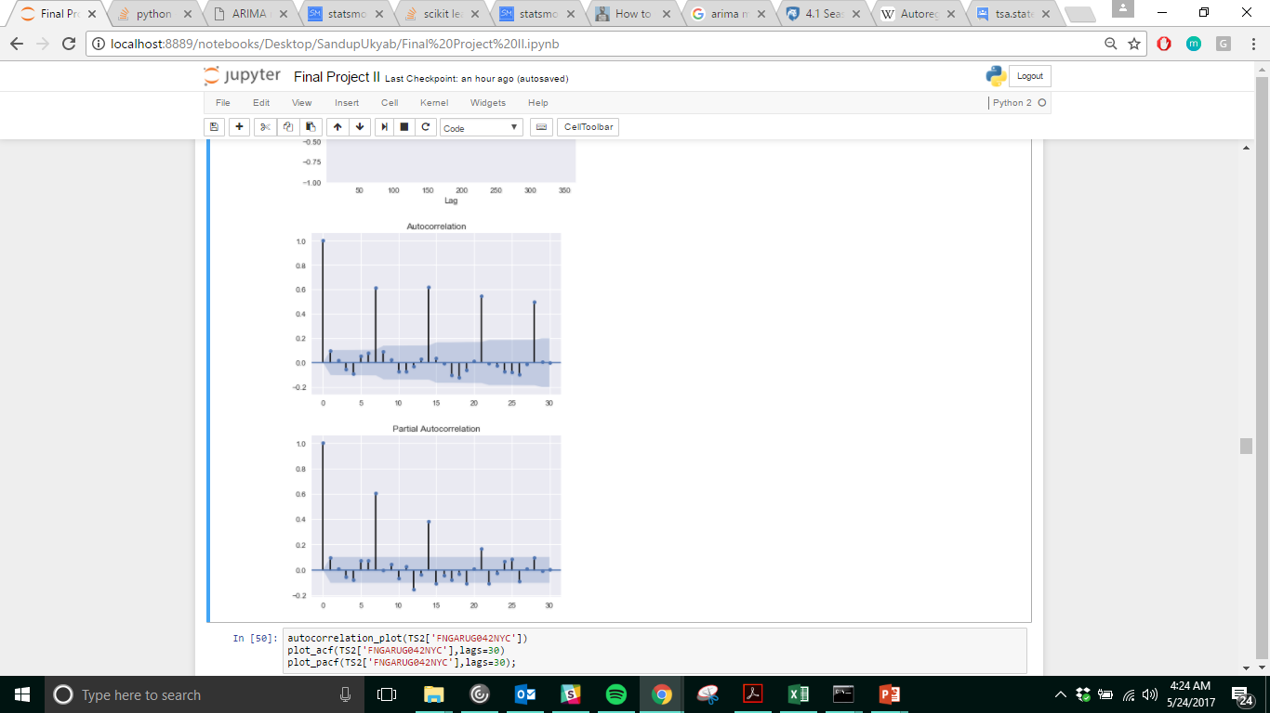
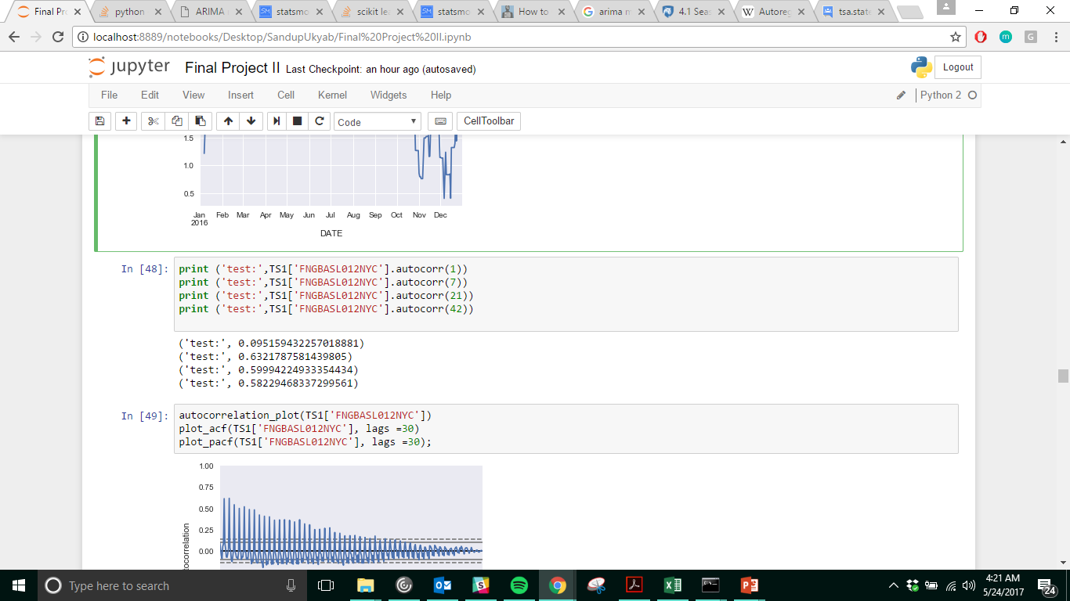
Rolling 7-day Mean
Autocorrelation Plot

Slide 11
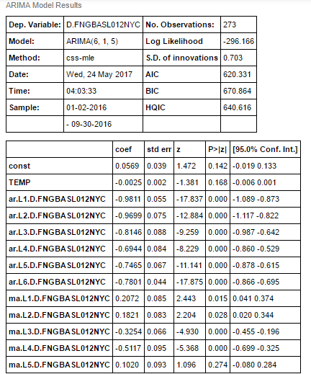
ARIMA MODEL ( w/ Exogenous Variable )
Lag (p) = 6
No. of Autoregressive Terms, using data from previous Time (lags) to predict the next.
Differencing (d) = 1
The no. of non-seasonal differences needed for stationarity. Predicting the difference between 2 consecutive values, this is so we can create a stationary model, on which we can use a Time Series Model.
Moving Avg. (q) = 5
Avg. of p surrounding data points in time (t)
TEMP = EXOGENOUS VARIABLE
An outside variable added to an ARIMA model, a variable that appear in the model but are not explained by the model(taken as given).

Slide 12
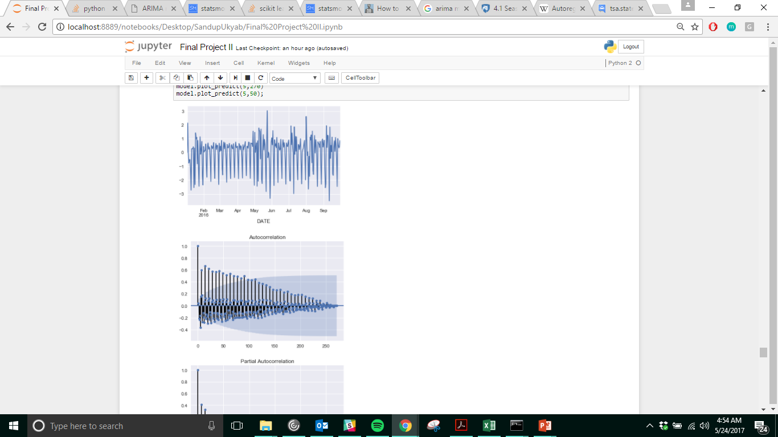
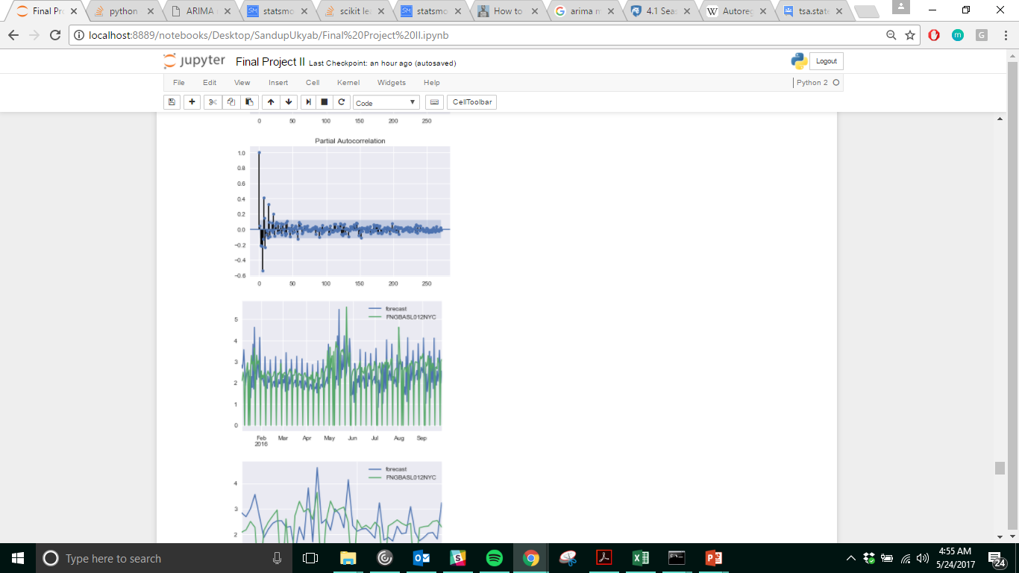
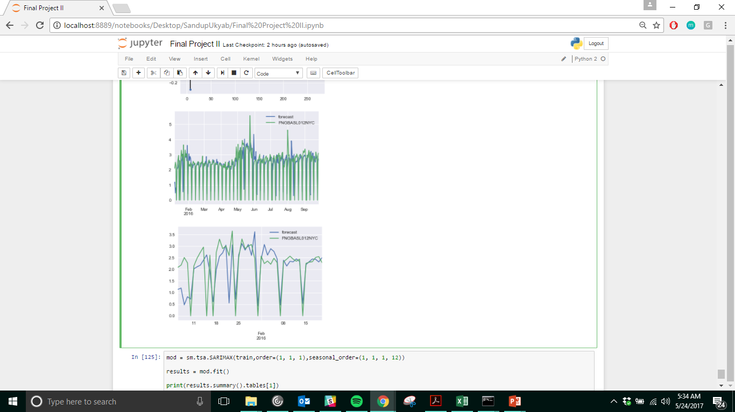
Residual Plot
PACF of Residual
ACF of Residual
270 day Forecast
50 day Forecast

Slide 13
CONCLUSION
Next Steps-
Use SARIMAX model to account for seasonality in the data.
Research inclusion of multiple exogenous variables.
If not, create a value using weighted sum of all the independent value (individual Linear Regression models, or Time Series model)
e.g. x = 0.4 Temp + 0.25 PAR + 0.2 CO2 + 0.15 RH, use x as exogenous variable.
ARIMA model showed better results than the Linear Regression Model and accounted for the exogenous variable too. However, the model only allows for 1 exogenous variable.*
The ARIMA model was able to forecast and compare with the Actual Data.

Slide 14
THANKS!
Any questions?

